Slide 1
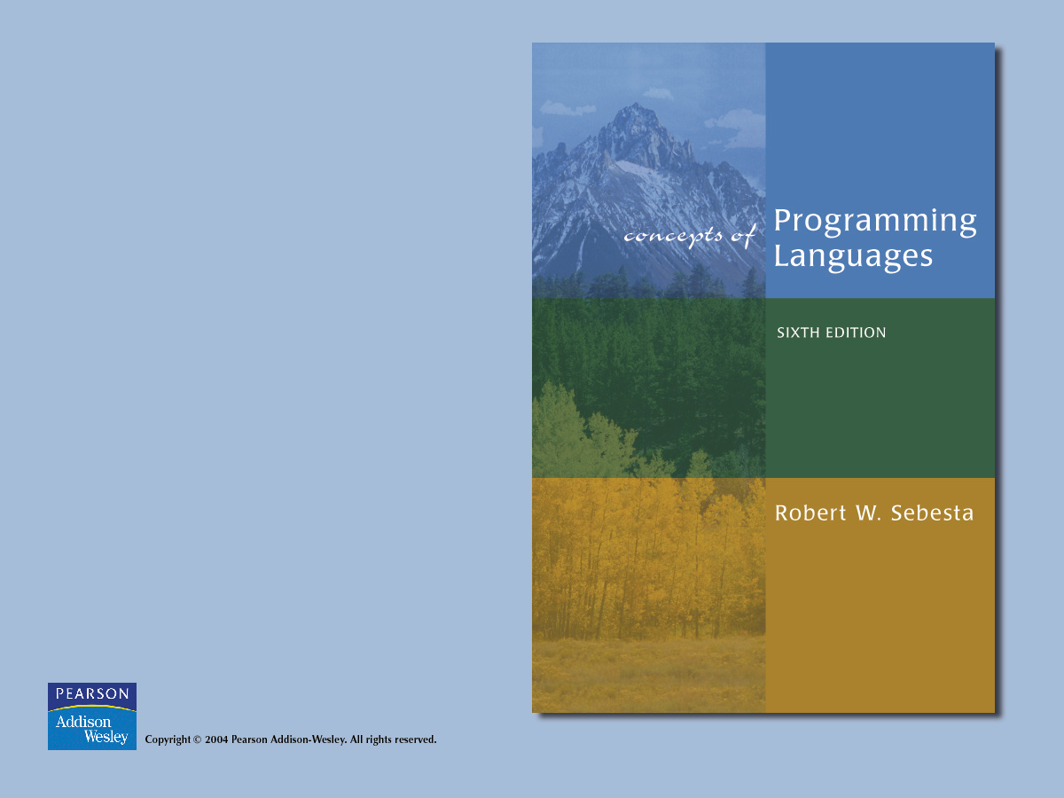
Chapter 3
Describing Syntax and Semantics

Slide 2

Chapter 3 Topics
Introduction
The General Problem of Describing Syntax
Formal Methods of Describing Syntax
Attribute Grammars
Describing the Meanings of Programs: Dynamic Semantics

Slide 3
Introduction
Who must use language definitions?
  Other language designers
  Implementors
  Programmers (the users of the language)
Syntax - the form or structure of the expressions, statements, and program units
Semantics - the meaning of the expressions, statements, and program units

Slide 4
Describing Syntax
A sentence is a string of characters over some alphabet
A language is a set of sentences
A lexeme is the lowest level syntactic unit of a language (e.g., *, sum, begin)
A token is a category of lexemes (e.g., identifier)

Slide 5
Describing Syntax
Formal approaches to describing syntax:
  Recognizers - used in compilers (we will look at in Chapter 4)
  Generators – generate the sentences of a language (what we'll study in this chapter)

Slide 6
Formal Methods of
Describing Syntax
Context-Free Grammars
  Developed by Noam Chomsky in the mid-1950s
  Language generators, meant to describe the syntax of natural languages
  Define a class of languages called context-free languages

Slide 7
Formal Methods of
Describing Syntax
Backus-Naur Form (1959)
  Invented by John Backus to describe Algol 58
  BNF is equivalent to context-free grammars
  A metalanguage is a language used to describe another language.
  In BNF, abstractions are used to represent classes of syntactic structures--they act like syntactic variables (also called nonterminal symbols)

Slide 8
Backus-Naur Form (1959)
<while_stmt> → while ( <logic_expr> ) <stmt>
This is a rule; it describes the structure of a while statement

Slide 9
Formal Methods of
Describing Syntax
A rule has a left-hand side (LHS) and a right-hand side (RHS), and consists of terminal and nonterminal symbols
A grammar is a finite nonempty set of rules
An abstraction (or nonterminal symbol) can have more than one RHS
<stmt> → <single_stmt>
| begin <stmt_list> end

Slide 10
Formal Methods of
Describing Syntax
Syntactic lists are described using recursion
<ident_list> → ident
| ident, <ident_list>
A derivation is a repeated application of rules, starting with the start symbol and ending with a sentence (all terminal symbols)

Slide 11
Formal Methods of
Describing Syntax
An example grammar:
<program> → <stmts>
<stmts> → <stmt> | <stmt> ; <stmts>
<stmt> → <var> = <expr>
<var> → a | b | c | d
<expr> → <term> + <term> | <term> - <term>
<term> → <var> | const

Slide 12
Formal Methods of
Describing Syntax
An example derivation:
<program> => <stmts> => <stmt>
=> <var> = <expr> => a = <expr>
=> a = <term> + <term>
=> a = <var> + <term>
=> a = b + <term>
=> a = b + const

Slide 13
Derivation
Every string of symbols in the derivation is a sentential form
A sentence is a sentential form that has only terminal symbols
A leftmost derivation is one in which the leftmost nonterminal in each sentential form is the one that is expanded
A derivation may be neither leftmost nor rightmost

Slide 14
Parse Tree
A hierarchical representation of a derivation
<program>
<stmts>
<stmt>
<var>
=
<expr>
a
<term>
+
<term>
<var>
const
b

Slide 15
Formal Methods of
Describing Syntax
A grammar is ambiguous iff it generates a sentential form that has two or more distinct parse trees

Slide 16
An Ambiguous
Expression Grammar
<expr> → <expr> <op> <expr> | const
<op> → / | -
<expr>
<expr>
<expr>
<op>
<expr>
<expr>
<op>
<op>
<expr>
<expr>
<op>
<expr>
<expr>
<op>
<expr>
const
-
const
/
const
const
-
const
/
const

Slide 17
An Unambiguous
Expression Grammar
If we use the parse tree to indicate precedence levels of the operators, we cannot have ambiguity
<expr> → <expr> - <term> | <term>
<term> → <term> / const | const
<expr>
<expr>
-
<term>
<term>
<term>
/
const
const
const

Slide 18
Formal Methods of
Describing Syntax
Derivation:
<expr> => <expr> - <term> => <term> - <term>
=> const - <term>
=> const - <term> / const
=> const - const / const

Slide 19
Formal Methods of Describing Syntax
Operator associativity can also be indicated by a grammar
<expr> -> <expr> + <expr> | const (ambiguous)
<expr> -> <expr> + const | const (unambiguous)
<expr>
<expr>
<expr>
+
const
<expr>
+
const
const

Slide 20
Formal Methods of
Describing Syntax
Extended BNF (just abbreviations):
  Optional parts are placed in brackets ([ ])
<proc_call> -> ident [ ( <expr_list>)]
  Put alternative parts of RHSs in parentheses and separate them with vertical bars
<term> -> <term> (+ | -) const
  Put repetitions (0 or more) in braces ({ })
<ident> -> letter {letter | digit}

Slide 21
BNF and EBNF
BNF:
<expr> → <expr> + <term>
| <expr> - <term>
| <term>
<term> → <term> * <factor>
| <term> / <factor>
| <factor>
EBNF:
<expr> → <term> {(+ | -) <term>}
<term> → <factor> {(* | /) <factor>}

Slide 22
Attribute Grammars (AGs) (Knuth, 1968)
Cfgs cannot describe all of the syntax of programming languages
Additions to cfgs to carry some semantic info along through parse trees
Primary value of AGs:
  Static semantics specification
  Compiler design (static semantics checking)

Slide 23
Attribute Grammars
Def: An attribute grammar is a cfg G = (S, N, T, P) with the following additions:
  For each grammar symbol x there is a set A(x) of attribute values
  Each rule has a set of functions that define certain attributes of the nonterminals in the rule
  Each rule has a (possibly empty) set of predicates to check for attribute consistency

Slide 24
Attribute Grammars
Let X₀ → X₁ ... X_{n} be a rule
Functions of the form S(X₀) = f(A(X₁), ... , A(X_{n})) define synthesized attributes
Functions of the form I(X_{j}) = f(A(X₀), ... , A(X_{n})), for i <= j <= n, define inherited attributes
Initially, there are intrinsic attributes on the leaves

Slide 25
Attribute Grammars
Example: expressions of the form id + id
  id's can be either int_type or real_type
  types of the two id's must be the same
  type of the expression must match it's expected type
BNF:
<expr> → <var> + <var>
<var> → id
Attributes:
  actual_type - synthesized for <var> and <expr>
  expected_type - inherited for <expr>

Slide 26
The Attribute Grammar
Syntax rule: <expr> → <var>[1] + <var>[2]
Semantic rules:
<expr>.actual_type ← <var>[1].actual_type
Predicate:
<var>[1].actual_type == <var>[2].actual_type
<expr>.expected_type == <expr>.actual_type
Syntax rule: <var> → id
Semantic rule:
<var>.actual_type ← lookup (<var>.string)

Slide 27
Attribute Grammars
How are attribute values computed?
  If all attributes were inherited, the tree could be decorated in top-down order.
  If all attributes were synthesized, the tree could be decorated in bottom-up order.
  In many cases, both kinds of attributes are used, and it is some combination of top-down and bottom-up that must be used.

Slide 28
Attribute Grammars
<expr>.expected_type ← inherited from parent
<var>[1].actual_type ← lookup (A)
<var>[2].actual_type ← lookup (B)
<var>[1].actual_type =? <var>[2].actual_type
<expr>.actual_type ← <var>[1].actual_type
<expr>.actual_type =? <expr>.expected_type

Slide 29
Semantics
There is no single widely acceptable notation or formalism for describing semantics
Operational Semantics
  Describe the meaning of a program by executing its statements on a machine, either simulated or actual. The change in the state of the machine (memory, registers, etc.) defines the meaning of the statement

Slide 30
Semantics
To use operational semantics for a high-level language, a virtual machine is needed
A hardware pure interpreter would be too expensive
A software pure interpreter also has problems:
  The detailed characteristics of the particular computer would make actions difficult to understand
  Such a semantic definition would be machine- dependent

Slide 31
Operational Semantics
A better alternative: A complete computer simulation
The process:
  Build a translator (translates source code to the machine code of an idealized computer)
  Build a simulator for the idealized computer
Evaluation of operational semantics:
  Good if used informally (language manuals, etc.)
  Extremely complex if used formally (e.g., VDL)

Slide 32
Semantics
Axiomatic Semantics
  Based on formal logic (predicate calculus)
  Original purpose: formal program verification
  Approach: Define axioms or inference rules for each statement type in the language (to allow transformations of expressions to other expressions)
  The expressions are called assertions

Slide 33
Axiomatic Semantics
An assertion before a statement (a precondition) states the relationships and constraints among variables that are true at that point in execution
An assertion following a statement is a postcondition
A weakest precondition is the least restrictive precondition that will guarantee the postcondition

Slide 34
Axiomatic Semantics
Pre-post form: {P} statement {Q}
An example: a = b + 1 {a > 1}
One possible precondition: {b > 10}
Weakest precondition: {b > 0}

Slide 35
Axiomatic Semantics
Program proof process: The postcondition for the whole program is the desired result. Work back through the program to the first statement. If the precondition on the first statement is the same as the program spec, the program is correct.

Slide 36
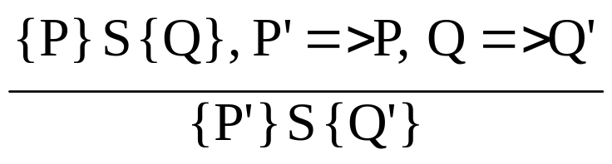
Axiomatic Semantics
An axiom for assignment statements
(x = E):
{Q_{x->E}} x = E {Q}
The Rule of Consequence:

Slide 37

Axiomatic Semantics
An inference rule for sequences
For a sequence S1;S2:
{P1} S1 {P2}
{P2} S2 {P3}
the inference rule is:

Slide 38
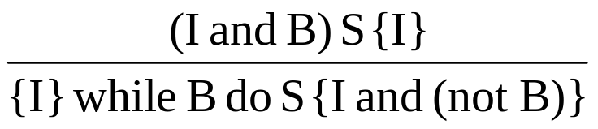
Axiomatic Semantics
An inference rule for logical pretest loops
For the loop construct:
{P} while B do S end {Q}
the inference rule is:
where I is the loop invariant (the inductive hypothesis)

Slide 39
Axiomatic Semantics
Characteristics of the loop invariant
I must meet the following conditions:
  P => I (the loop invariant must be true initially)
  {I} B {I} (evaluation of the Boolean must not
  change the validity of I)
  {I and B} S {I} (I is not changed by executing the
  body of the loop)
  (I and (not B)) => Q (if I is true and B is false, Q
  is implied)
  The loop terminates (this can be difficult to prove)

Slide 40
Axiomatic Semantics
The loop invariant I is a weakened version of the loop postcondition, and it is also a precondition.
I must be weak enough to be satisfied prior to the beginning of the loop, but when combined with the loop exit condition, it must be strong enough to force the truth of the postcondition

Slide 41
Semantics
Evaluation of axiomatic semantics:
  Developing axioms or inference rules for all of the statements in a language is difficult
  It is a good tool for correctness proofs, and an excellent framework for reasoning about programs, but it is not as useful for language users and compiler writers

Slide 42
Semantics
Denotational Semantics
  Based on recursive function theory
  The most abstract semantics description method
  Originally developed by Scott and Strachey (1970)

Slide 43
Denotational Semantics
The process of building a denotational spec for a language (not necessarily easy):
  Define a mathematical object for each language entity
  Define a function that maps instances of the language entities onto instances of the corresponding mathematical objects
The meaning of language constructs are defined by only the values of the program's variables

Slide 44
Semantics
The difference between denotational and operational semantics: In operational semantics, the state changes are defined by coded algorithms; in denotational semantics, they are defined by rigorous mathematical functions

Slide 45
Denotational Semantics
The state of a program is the values of all its current variables
s = {<i₁, v₁>, <i₂, v₂>, …, <i_{n}, v_{n}>}
Let VARMAP be a function that, when given a variable name and a state, returns the current value of the variable
VARMAP(i_{j}, s) = v_{j}

Slide 46
Semantics
Decimal Numbers
  The following denotational semantics description maps decimal numbers as strings of symbols into numeric values

Slide 47
Semantics
<dec_num> → 0 | 1 | 2 | 3 | 4 | 5 | 6 | 7 | 8 | 9
| <dec_num> (0 | 1 | 2 | 3 | 4 |
5 | 6 | 7 | 8 | 9)
M_{dec}('0') = 0, M_{dec} ('1') = 1, …, M_{dec} ('9') = 9
M_{dec} (<dec_num> '0') = 10 * M_{dec} (<dec_num>)
M_{dec} (<dec_num> '1’) = 10 * M_{dec} (<dec_num>) + 1
…
M_{dec} (<dec_num> '9') = 10 * M_{dec} (<dec_num>) + 9

Slide 48
Semantics
Expressions
  Map expressions onto Z ∪ {error}
  We assume expressions are decimal numbers, variables, or binary expressions having one arithmetic operator and two operands, each of which can be an expression

Slide 49
Semantics
M_{e}(<expr>, s) Δ=
case <expr> of
<dec_num> => M_{dec}(<dec_num>, s)
<var> =>
if VARMAP(<var>, s) == undef
then error
else VARMAP(<var>, s)
<binary_expr> =>
if (M_{e}(<binary_expr>.<left_expr>, s) == undef
OR M_{e}(<binary_expr>.<right_expr>, s) =
undef)
then error
    else
    if (<binary_expr>.<operator> == ‘+’ then
    M_{e}(<binary_expr>.<left_expr>, s) +
    M_{e}(<binary_expr>.<right_expr>, s)
    else M_{e}(<binary_expr>.<left_expr>, s) *
    M_{e}(<binary_expr>.<right_expr>, s)
    ...

Slide 50
Semantics
Assignment Statements
  Maps state sets to state sets
Ma(x := E, s) Δ=
if Me(E, s) == error
then error
else s’ = {<i₁’,v₁’>,<i₂’,v₂’>,...,<i_{n}’,v_{n}’>},
where for j = 1, 2, ..., n,
v_{j}’ = VARMAP(i_{j}, s) if i_{j} <> x
= Me(E, s) if i_{j} == x

Slide 51
Semantics
Logical Pretest Loops
  Maps state sets to state sets
M_{l}(while B do L, s) Δ=
if M_{b}(B, s) == undef
then error
else if M_{b}(B, s) == false
then s
else if M_{sl}(L, s) == error
then error
else M_{l}(while B do L, M_{sl}(L, s))

Slide 52
Semantics
The meaning of the loop is the value of the program variables after the statements in the loop have been executed the prescribed number of times, assuming there have been no errors
In essence, the loop has been converted from iteration to recursion, where the recursive control is mathematically defined by other recursive state mapping functions
Recursion, when compared to iteration, is easier to describe with mathematical rigor

Slide 53
Semantics
Evaluation of denotational semantics:
  Can be used to prove the correctness of programs
  Provides a rigorous way to think about programs
  Can be an aid to language design
  Has been used in compiler generation systems

